Slide 1
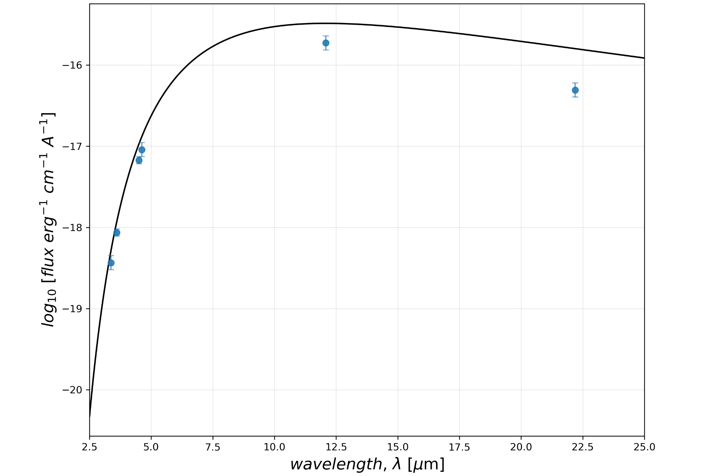
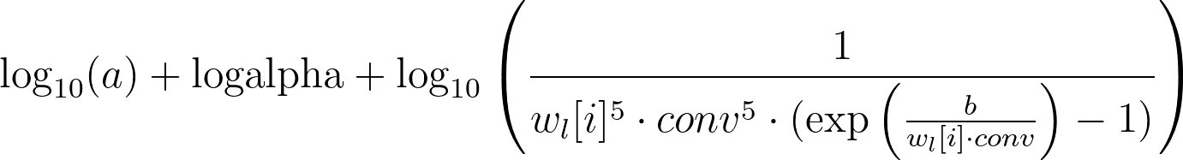
LAB 2: MCMC - Jorge Casas, Pablo Drake
We will be looking at the raw flux data and fitting the Planck Distribution to this data. Doing so, iteratively via Markov Chain Monte Carlo simulation, we can estimate the effective temperature, T_{eff} of cool brown dwarfs.
(1)
(2)
These are the main equations in use for the MCMC algorithm.
Eq. 1 is the model equation that will calculate the log of the flux parameter with T_{eff} embedded in the b variable.
Eq. 2 is the likelihood function used in this algorithm, which will calculate the likelihood probability of trial parameters.
The raw data points come in log-linear space, with the flux in logarithmic scale and the wavelength in a linear scale. Plotting a black-body distribution on this interval and fitting it manually gives us this.

Slide 2
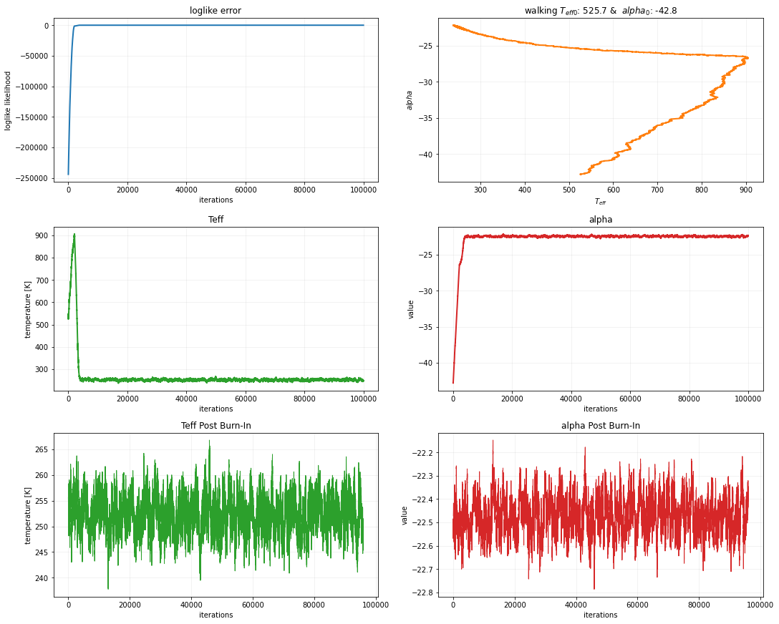
On the initial run for our custom MCMC, we corroborated the validity of the code by plotting diagnostic plots.
On the top left, the plot of the likelihood function over the amount of iterations for the loop, which was maxed out at 100,000 iterations. Top right, the plot of the walking parameters T_{eff} and alpha shows the initial conditions set by the uniform function as printed in the title.
Middle left, shows the plot of the T_{eff} temperature value over the iterations, including the burn in stage. The same is shown for the alpha value in the middle right plot.
Lastly, the bottom two plots show the same as the middle two plots post burn in via a median method. This shows that the parameter is normally distributed about the median

Slide 3
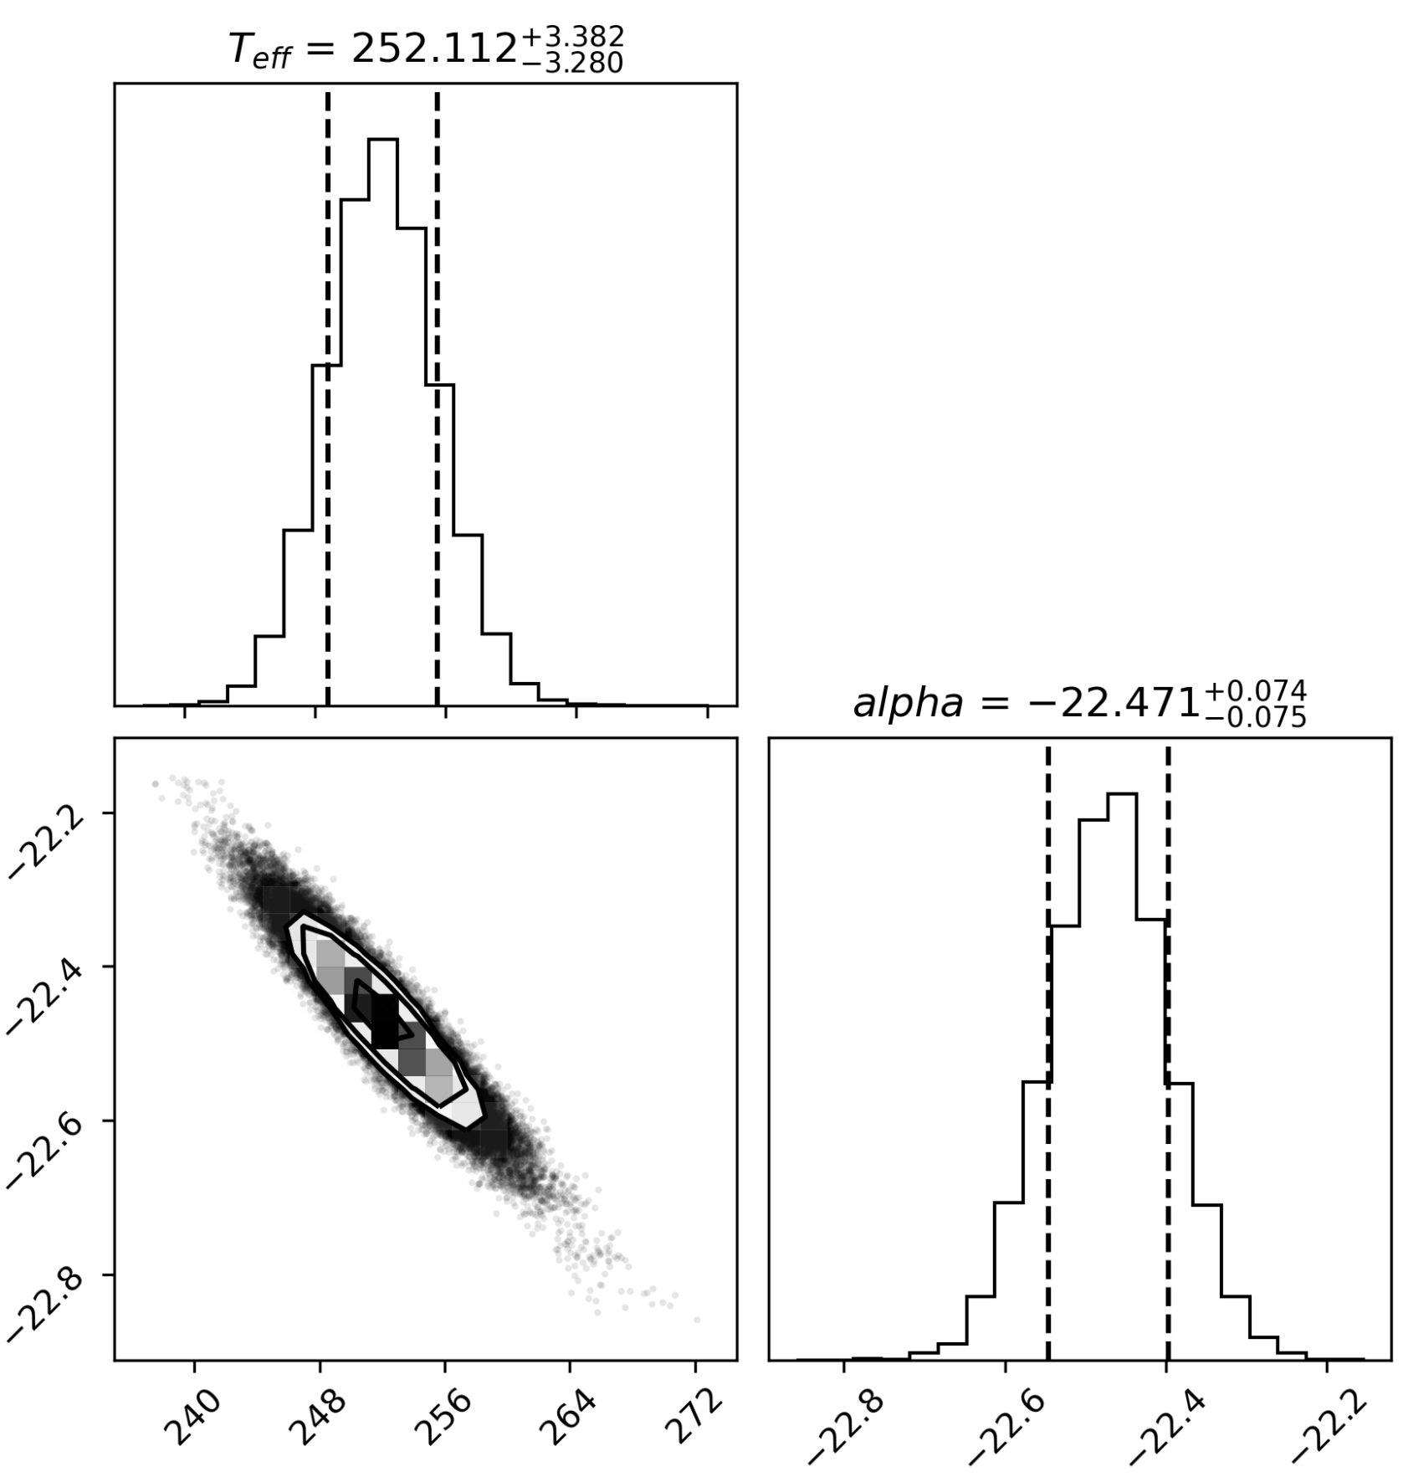
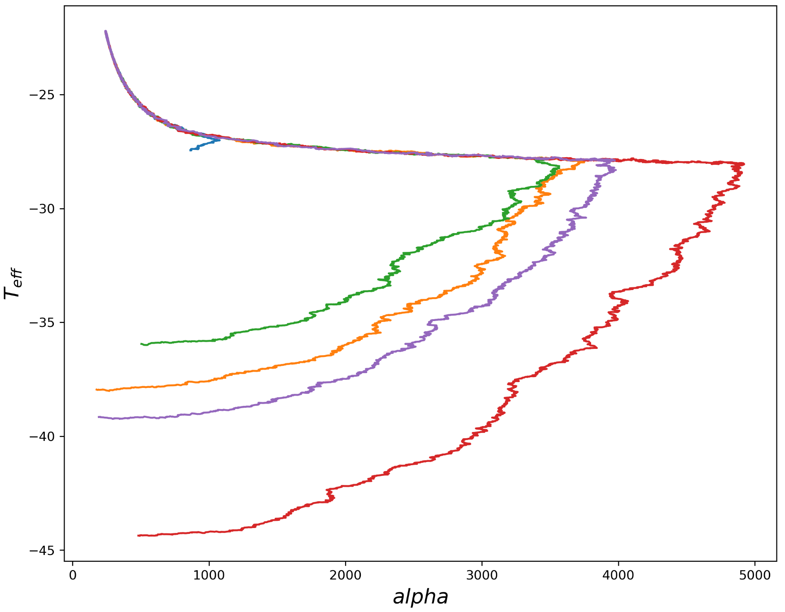
From the Log-Uniform Posterior Distributions Medians:
T_{eff}: 252.11 +3.38/-3.28 [K]
alpha: -22.47 +0.07/-0.08
From the Uniform Posterior Distributions Medians:
T_{eff}: 251.66 +3.25/-3.15 [K]
alpha: -22.46 +0.07/-0.07
From the Uniform T⁴ Posterior Distributions Medians:
T_{eff}: 252.11 +3.38/-3.28 [K]
alpha: -22.47 +0.07/-0.08
The top right corner plot is a sample of the Log-Uniform posterior distributions sampled from the MCMC algorithm, showing a correlation between the alpha term and the T_{eff} term.
The bottom plot is also showcasing 5 iterations of the same MCMC run, all starting from different conditions and arriving at the same final condition, to within error of each other.

